Slide 1



C# Fundamentals StringBuilder

Slide 2
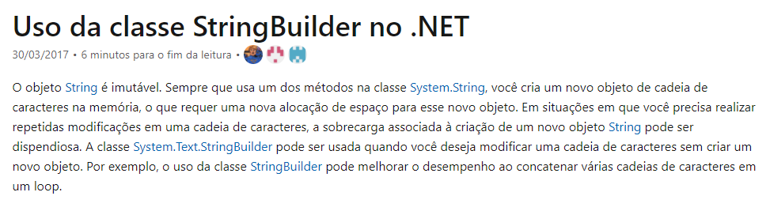
StringBuilder:

Slide 3
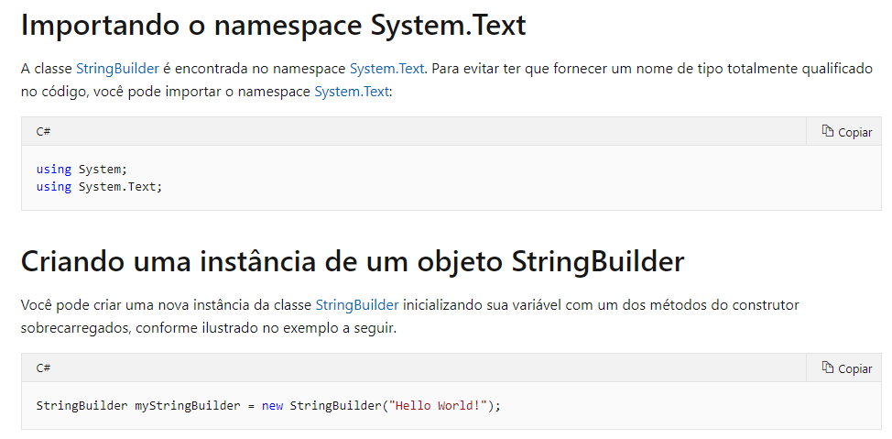
StringBuilder:

Slide 4
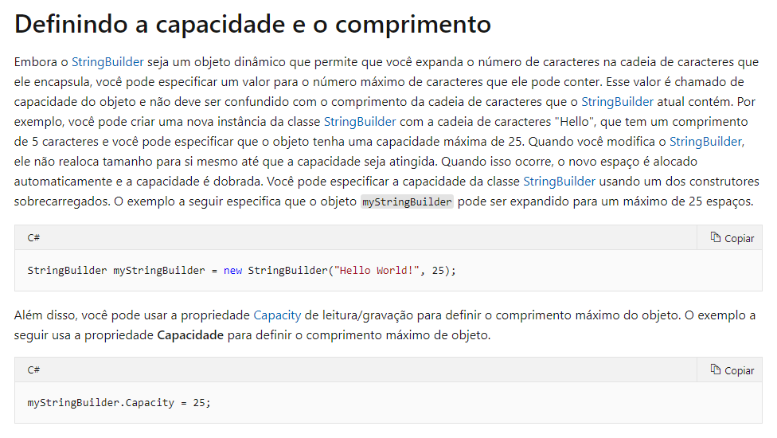
StringBuilder:

Slide 5
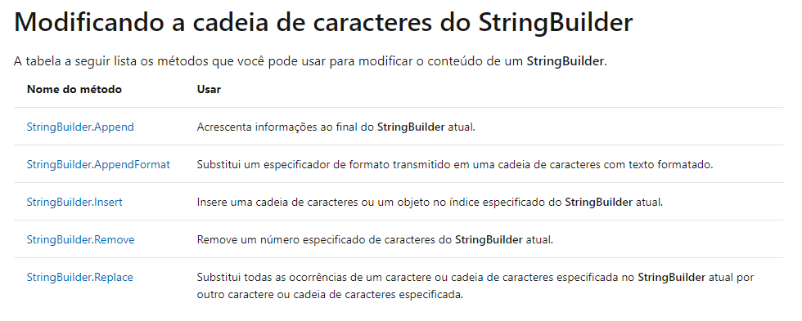
StringBuilder:

Slide 6
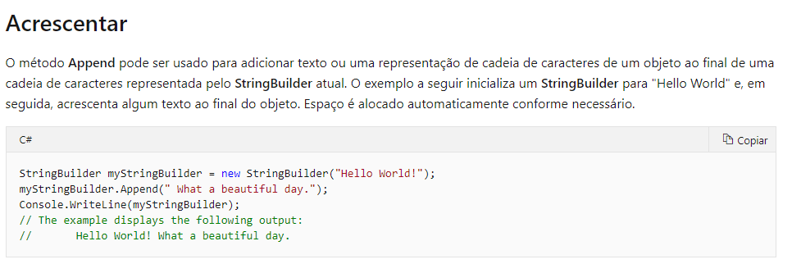
StringBuilder:

Slide 7
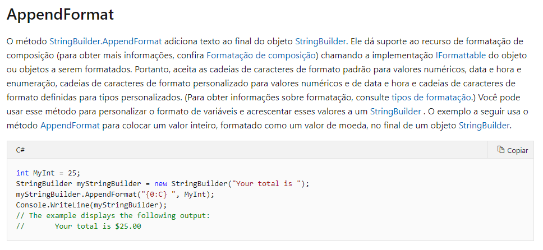
StringBuilder:

Slide 8
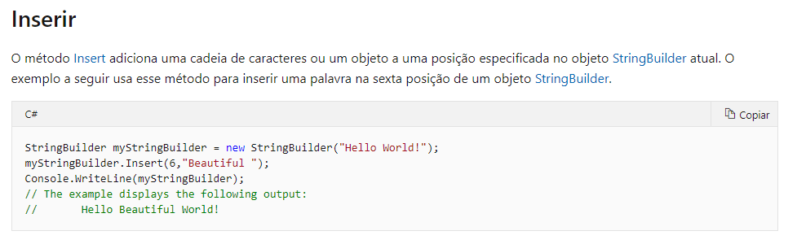
StringBuilder:

Slide 9
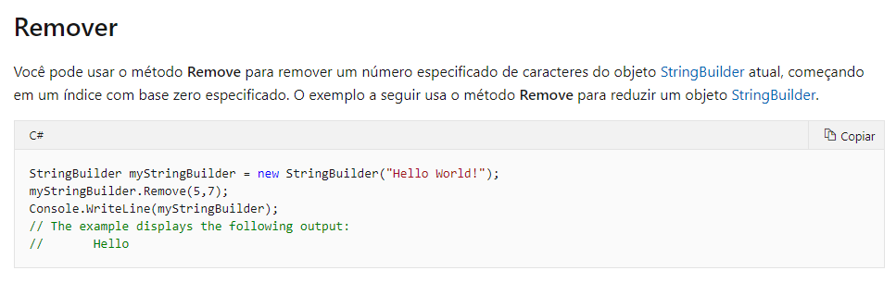
StringBuilder:

Slide 10
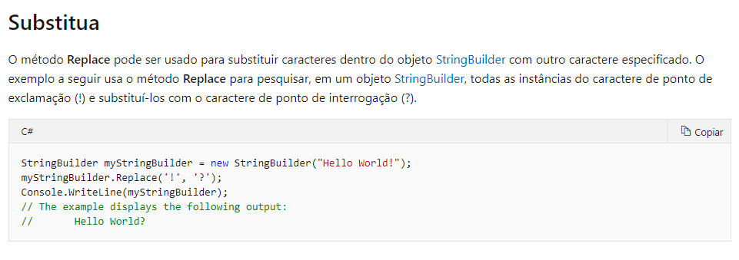
StringBuilder:

Slide 11
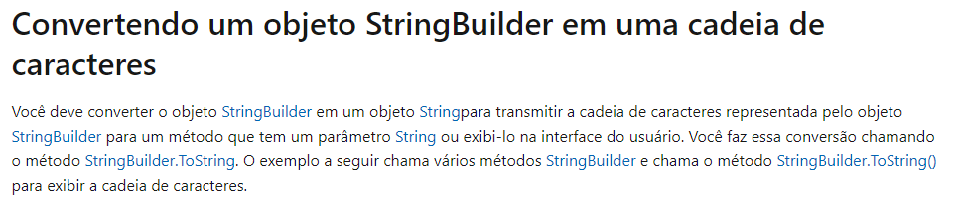
StringBuilder:

Slide 12
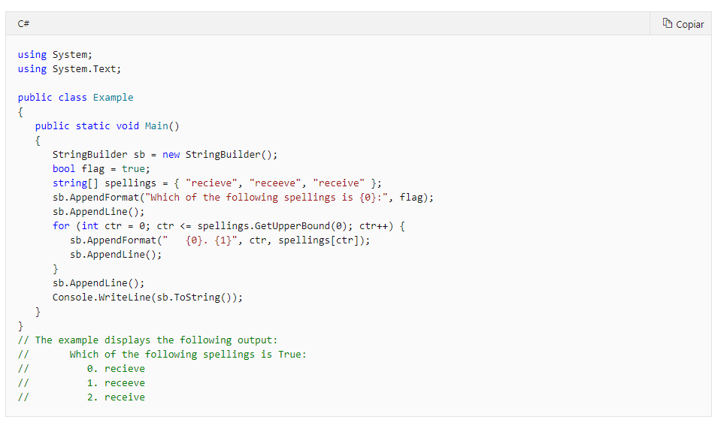
StringBuilder:

Slide 13
StringBuilder:
Links de documentação oficial:
Documentação:
https://docs.microsoft.com/pt-br/dotnet/standard/base-types/stringbuilder

Slide 14
Dúvidas?

